Slide 1

Acid-base Equilibrium

Slide 2
Contents:
Acid and bases: a brief review
The autoionization of water
The pH scale
Strong acids and bases
Weal acids and bases
Relationship between K_{a} and K_{b}
Acid-base properties of salt solutions

Slide 3
Acid-base Equilibrium
Acids and bases: a brief review

Slide 4
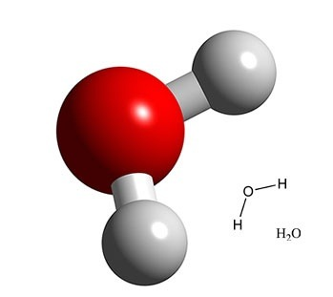
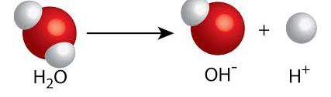
Acids and bases: a brief review
Water is the most commonly used medium in chemical
reactions.
Water has a chemical formula of H₂O
In which the highly electronegative O
atom is directly bonded to 2 H atoms
Through covalent bonds
Water molecules partially
ionize to H⁺ and OH⁻ ions,
where, [H⁺] = [OH⁻]
H⁺ are called Hydrogen ions or (protons)
OH⁻ are called hydroxyl ions

Slide 5
Acids and bases: a brief review
Water molecules partially ionize to H⁺ and OH⁻ ions,
where, [H⁺] = [OH⁻]
H⁺ ions represent the acidic nature of water, while
[OH⁻] ions represent the basic nature of water
Because [H⁺] = [OH⁻] in pure water,
→ Water is neither acidic nor neutral
Acids and Bases

Slide 6
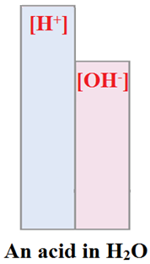

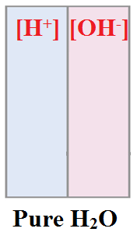

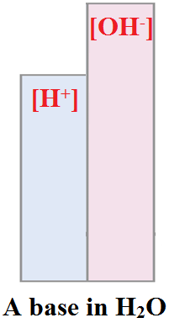

Acids and bases: a brief review
Arrhenius acids
Acids are proton donors;
increase [H⁺] in solution
Example:
Arrhenius bases
Bases are hydroxyl donors;
increase [OH⁻] in solution
Example:

Slide 7
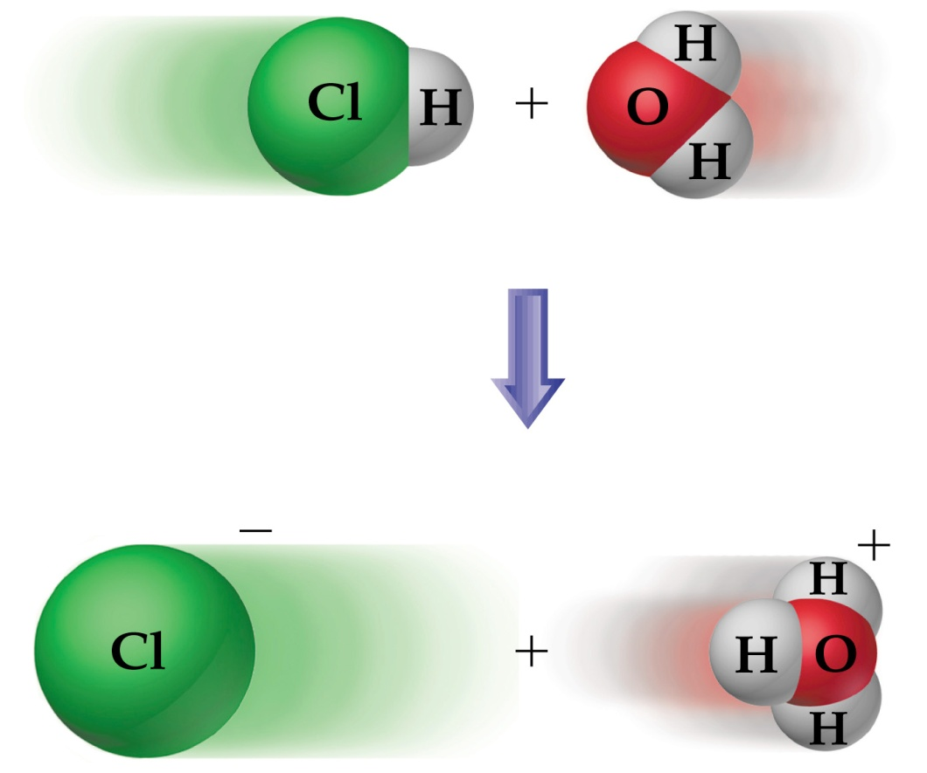
Acids and bases: a brief review
Brønsted-Lowry acids
Acids are proton donors;
Brønsted-Lowry bases
Bases are proton acceptors;
Example:
HCl_{(aq)} + H₂O_{(l)} → H₃O⁺_{(aq)} + Cl⁻_{(aq)}
BL acid
BL base

Slide 8
Acids and bases: a brief review
Amphoteric properties
A material that has the ability to donate or accept a proton is said to have amphoteric properties.
i.e. it behaves as an acid and as a base !!!
Example:
H₂O has amphoteric properties, as it behaves as an acid with bases and as a base with acids, as follows:
H₂O as an acid: NH₃ + H₂O → NH₄⁺ + OH⁻
H₂O as a base HCl_{(aq)} + H₂O_{(l)} → H₃O⁺_{(aq)} + Cl⁻_{(aq)}

Slide 9
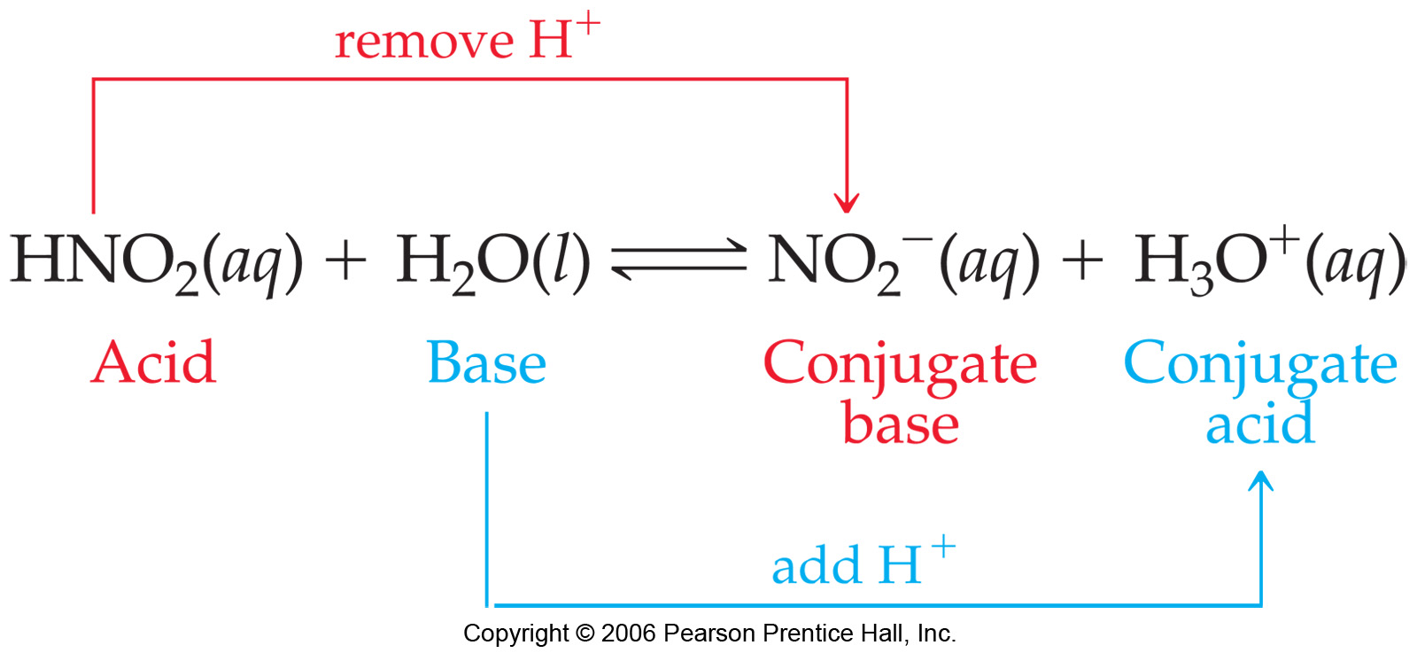
Acids and bases: a brief review
Conjugate acid and conjugate base:
A conjugate acid is the result of a base accepting a proton
A conjugate base is the result of an acid losing a proton

Slide 10
Acids and bases: a brief review
Conjugate acid and conjugate base:
Example:
Define the conjugate acid and conjugate base in each of the following reactions:
HNO_{2 (aq)} + H₂O _{(l)} NO₂⁻ _{(aq)}+ H₃O⁺ _{(aq)}
Conjugate acid
Conjugate base
NH_{3 (aq)} + H₂O _{(l)} NH₄⁺ _{(aq)}+ OH⁻ _{(aq)}

Slide 11

Acids and bases: a brief review
Relative Strengths of Acids and Bases
Strong acids are completely dissociated in water.
Their conjugate bases are quite weak. i.e. CANNOT recombine with H⁺ to produce the acid again
(a one-way reaction)
Example: HCl
HCl_{(aq)} → H⁺_{(aq)} + Cl⁻_{(aq)}
Weak acids are partially dissociated in water.
Their conjugate bases are weak. i.e. CAN still recombine with H⁺ to produce the acid again
(an equilibrium reaction)
Example: HF
HF_{(aq)} H⁺_{(aq)} + F⁻_{(aq)}

Slide 12
Acids and bases: a brief review
Relative Strengths of Acids and Bases
Strong bases are completely dissociated in water.
Their conjugate acids are quite weak. i.e. CANNOT recombine with OH⁻ to produce the base again
(a one-way reaction)
Example: NaOH
NaOH_{(aq)} → Na⁺_{(aq)} + OH⁻_{(aq)}
Weak bases are partially dissociated in water.
Their conjugate acids are weak. i.e. CAN still recombine with OH⁻ to produce the base again
(an equilibrium reaction)
Example: NH₃
NH_{3(aq)} + H₂O _{(l)} NH₄⁺_{(aq)} + OH⁻_{(aq)}

Slide 13
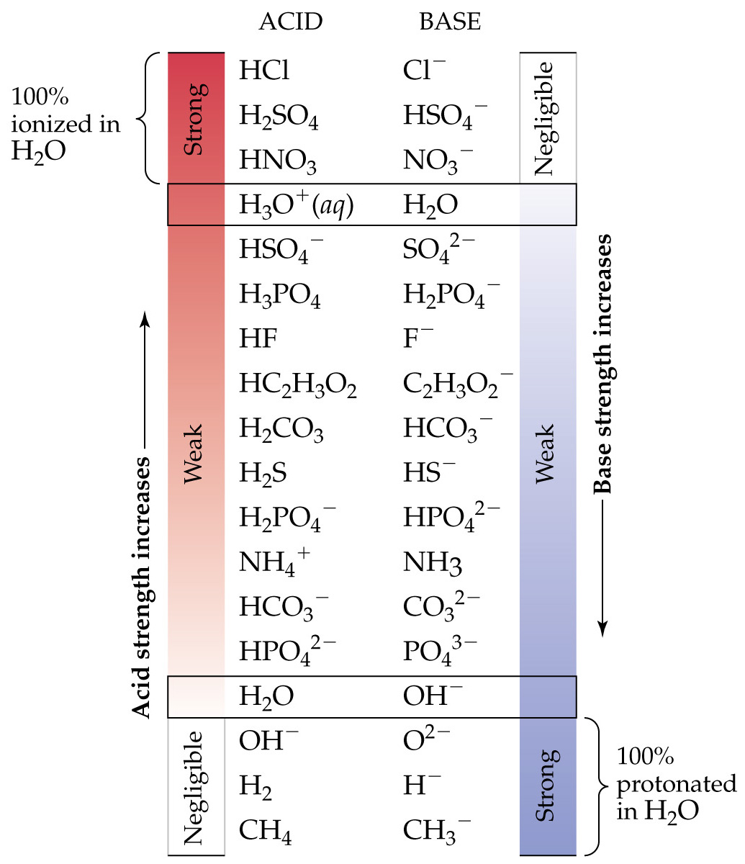
Brønsted-Lowry Acids and Bases
Strong
Acids & bases
(One-way
reactions)
Weak
Acids & bases
(Equilibrium
reactions)

Slide 14
Acid-base Equilibrium
The autoionization of water

Slide 15
The autoionization of water
The Ion Product of Water
In pure water the following equilibrium is established at 25°C
This is called the autoionization of H₂O, which is treated as an equilibrium reaction with a K_{eq} constant known as K_{w}
The very small value of K_{w} indicates that ionization of H₂O takes place to a very small extent

Slide 16

The autoionization of water
The Ion Product of Water
Example:
Calculate the concentration of OH ⁻ (aq) in a solution in which:
a) [H⁺] = 2 x 10⁻⁶ M b) [H⁺] = [OH⁻] c) [H⁺] = 100 x [OH⁻]
Solution Approach
Use the relation between [H⁺] and [OH⁻]
to directly calculate the value of [OH⁻] in each of these solutions

Slide 17
The autoionization of water
The Ion Product of Water
Example:
Calculate the concentration of OH ⁻ (aq) in a solution in which:
a) [H⁺] = 2 x 10⁻⁶ M b) [H⁺] = [OH⁻] c) [H⁺] = 100 x [OH⁻]
Solution:
a) [H⁺] = 2 x 10⁻⁶ M
→
[OH⁻] = 1.0 x 10⁻¹⁴ / 2 x 10⁻⁶ = 5 x 10⁻⁹ M
b) [H⁺] = [OH⁻]
→
[OH⁻]² = 1.0 x 10⁻¹⁴ → [OH⁻] = 10⁻⁷ M
c) [H⁺] = 100 x [OH⁻]
→
[OH⁻] = 1.0 x 10⁻¹⁴ / 100 [OH⁻] → [OH⁻] = 10⁻⁸ M

Slide 18
The autoionization of water
The Ion Product of Water
Example:
Indicate whether a solution with each of the following ion
concentrations is neutral, acidic, or basic:
[H⁺] = 4 x 10⁻⁹ M
[OH⁻] = 1 x 10⁻⁷ M
[OH⁻] = 7 x 10⁻¹³ M
Solution Approach

Slide 19
The autoionization of water
The Ion Product of Water
Example:
Indicate whether a solution with each of the following ion
concentrations is neutral, acidic, or basic:
[H⁺] = 4 x 10⁻⁹ M b) [OH⁻] = 1 x 10⁻⁷ M
c) [OH⁻] = 7 x 10⁻¹³ M
Solution Approach
Considering the relationship between [H⁺] and [OH⁻],
A scale can be built for the [H⁺], where:
> 10⁻⁷
10⁻⁷
> 10⁻⁷
[H⁺]
acidic
neutral
basic

Slide 20
The autoionization of water
The Ion Product of Water
Example:
Indicate whether a solution with each of the following ion
concentrations is neutral, acidic, or basic:
[H⁺] = 4 x 10⁻⁹ M b) [OH⁻] = 1 x 10⁻⁷ M
c) [OH⁻] = 7 x 10⁻¹³ M
Solution:
a) [H⁺] = 4 x 10⁻⁹ M
→
This value is below 10⁻⁷, so it is basic
a) [OH⁻] = 1 x 10⁻⁷ M
→
This value is for [OH⁻], → [H⁺] = 10⁻⁷, so it is neutral
a) [OH⁻] = 7 x 10⁻¹³ M
→
This value is for [OH⁻], → [H⁺] = 0.014; which is > 10⁻⁷,
so it is acidic

Slide 21
Acid-base Equilibrium
The pH scale

Slide 22


The pH scale
It is a fact that the value of [H⁺] in most aqueous solutions is
so small.
→ Instead a relation is used to express the [H⁺] as pH
Where:
Therefore: &
Accordingly, a new scale is designed for the pH of the solution:
< 7
7
> 7
pH
acidic
neutral
basic

Slide 23
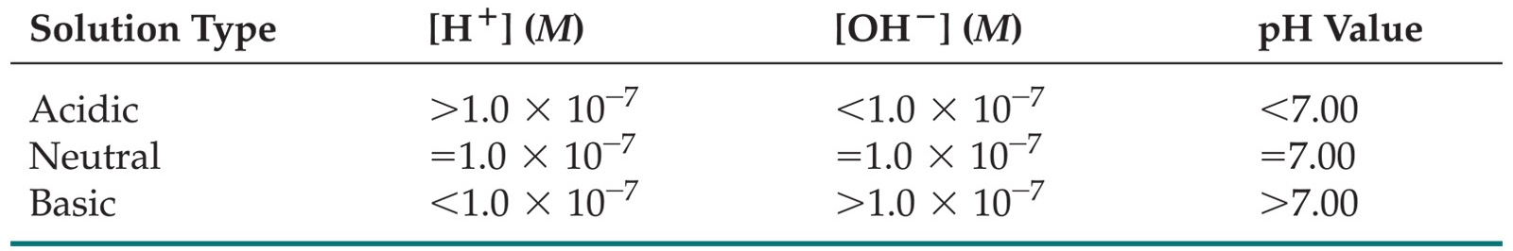
The pH scale
Note:
Based on the relation between [H⁺] and [OH⁻] through K_{w},
A similar relation between pH and pOH can be obtained as:
pH + pOH = 14
Therefore, definition of the acidity of a solution is based on
The following table:

Slide 24
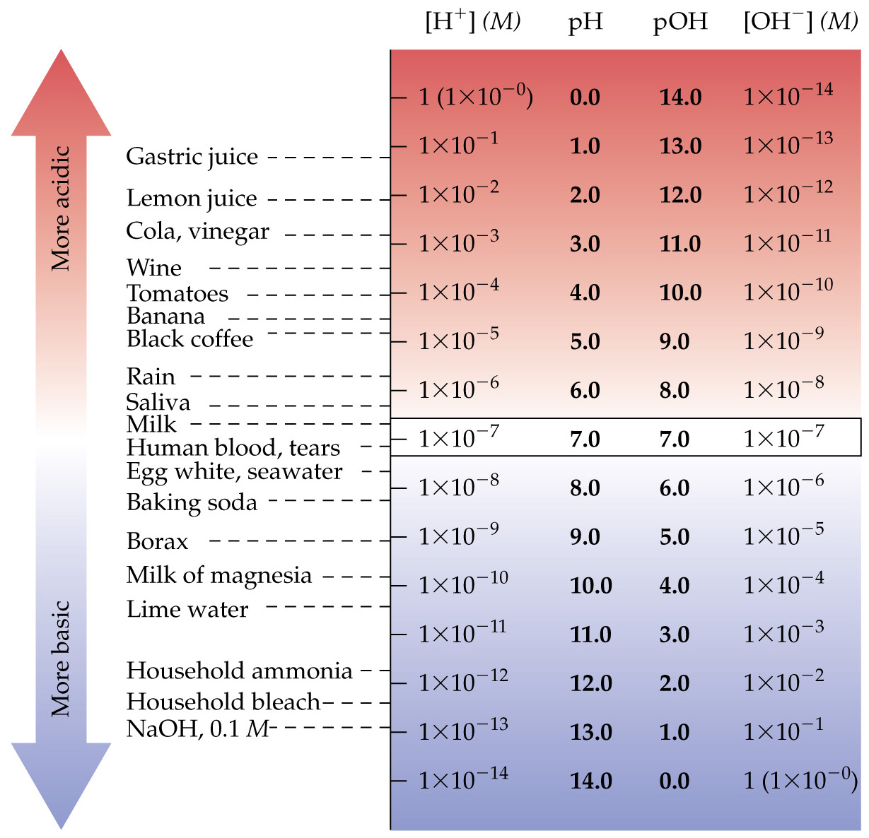
The pH scale
Real-life Examples

Slide 25
The pH scale
Example:
Complete the following table by calculating the missing
entries and indicating whether the solution is acidic,
basic or neutral
[ H⁺], M | [OH⁻], M | pH | pOH | Acidic, basic, or neutral
7.5 x 10⁻³
 | 3.6 x 10⁻¹⁰
 |  | 8.25
 |  |  | 5.70
Solution Approach

Slide 26
The pH scale
Example:
Complete the following table by calculating the missing
entries and indicating whether the solution is acidic,
basic or neutral
Solution:
To solve this problem, the following relations and the table
should be used
pH + pOH = 14

Slide 27
Acid-base Equilibrium
Strong acids and strong bases

Slide 28
Strong acids and Strong bases
Recall:
Strong acids are completely dissociated in water.
Their conjugate bases are quite weak. i.e. CANNOT recombine with H⁺ to produce the acid again
(a one-way reaction)
Strong bases are completely dissociated in water.
Their conjugate acids are quite weak. i.e. CANNOT recombine with OH⁻ to produce the base again
(a one-way reaction)
Therefore, The pH of a strong acid or a strong base is directly calculated using their initial molarities

Slide 29
Strong acids and Strong bases
Note:
Strong acids
Include:
HCl, HBr, HI, HNO₃, H₂SO₄, HClO₄, HClO₃
Note:
HF is a weak acid
Strong bases
Include:
Hydroxides of group I (LiOH, NaOH, KOH, RbOH, CsOH)
Hydroxides of group II (Ca(OH)₂, Sr(OH)₂, Ba(OH)₂
Note:
Be(OH)₂, and Mg(OH)₂ are weak bases

Slide 30
Strong acids and Strong bases
Example:
What is the pH of the following:
A 0.028 M solution of NaOH
A 0.0011 M solution of Ca(OH)₂
A 0.04 M solution of HClO₄
Solution Approach
In these problems, it is always recommended to write the
ionization reaction of the acid or the base to decide on the
stoichiometry of the reaction

Slide 31
Strong acids and Strong bases
Example:
What is the pH of the following:
A 0.028 M solution of NaOH
A 0.0011 M solution of Ca(OH)₂
A 0.04 M solution of HClO₄
Solution:
a) NaOH → Na⁺ + OH⁻
The stoichiometric relation between NaOH and OH⁻ is 1:1
[OH⁻] = [NaOH] = 0.028 M → pOH = -log[OH⁻]
pH = 14 - pOH

Slide 32
Strong acids and Strong bases
Example:
What is the pH of the following:
A 0.028 M solution of NaOH
A 0.0011 M solution of Ca(OH)₂
A 0.04 M solution of HClO₄
Solution:
b) Ca(OH)₂ → Ca²⁺ + 2OH⁻
The stoichiometric relation between Ca(OH)₂ and OH⁻ is 1:2
[OH⁻] = 2 [Ca(OH)₂] = 2 x 0.0011 M → pOH = -log[OH⁻]
pH = 14 - pOH

Slide 33
Strong acids and Strong bases
Example:
What is the pH of the following:
A 0.028 M solution of NaOH
A 0.0011 M solution of Ca(OH)₂
A 0.04 M solution of HClO₄
Solution:
c) HClO₄ → H⁺ + ClO₄⁻
The stoichiometric relation between HClO₄ and H⁺ is 1:1
[H⁺] = [HClO₄] = 0.04 M → pH = -log[H⁺]

Slide 34
Strong acids and Strong bases
Example:
What is the [H⁺] of the following:
KOH solution with a pH of 11.89
Ca(OH)₂ solution with a pH of 11.68
HNO₃ solution with a pH of 2.34
Solution Approach
In these problems, [H⁺] can be directly calculated from the
relation pH = -log[H⁺], which can be rearranged to:
[H⁺] = 10^{-pH}

Slide 35
Strong acids and Strong bases
Strong non-hydroxide bases:
Certain salts do not have (OH) in their structure, but are considered strong bases because they completely dissolve in water producing OH⁻ ions. Those are:
Hydrides H⁻_{(aq)} + H₂O_{(l)} → H_{2(g)} + OH⁻_{(aq)}
Oxides: O²⁻_{(aq)} + H₂O_{(l)} → 2OH⁻_{(aq)}
Nitrides N³⁻_{(aq)} + H₂O_{(l)} → NH_{3(aq)} + 3OH⁻_{(aq)}
Hint:
The number of OH⁻ ions produced is equal to the charge on
the anion: H- produces 1 OH⁻, O²⁻ produces 2OH⁻,
while N³⁻ produces 3OH⁻ ions

Slide 36
Strong acids and Strong bases
Example:
Calculate the pH of solution made by dissolving 3.5 grams of Potassium Oxide in 0.5L of pure water
Solution Approach
K₂O has the O²⁻ ions that will produce 2OH⁻ ions,
according to:
Therefore, the [OH⁻] = 2 x M_{K2O}
M_{K2O} = n_{K2O} / 0.5 L, where n_{K2O} = 3.5 / (39x2 + 16)
Calculating [OH-] → pOH → pH
O²⁻_{(aq)} + H₂O_{(l)} → 2OH⁻_{(aq)}

Slide 37
Acid-base Equilibrium
Weak acids and weak bases

Slide 38
Weak acids and Weak bases
Recall:
Weak acids are partially dissociated in water.
Their conjugate bases are weak. i.e. CAN still recombine with H⁺ to produce the acid again
(an equilibrium reaction)
Weak bases are partially dissociated in water.
Their conjugate acids are weak. i.e. CAN still recombine with OH⁻ to produce the base again
(an equilibrium reaction)
Therefore, The pH of a weak acid or a weak base is calculated through equilibrium calculations

Slide 39
Weak acids and Weak bases
Note:
Weak acids
Include:
HF, HNO₂, HClO, HClO₂, H₂SO₃, H₂CO₃, H₂C₂O₄, ..etc
All organic acids
Weak bases
Include:
Be(OH)₂, and Mg(OH)₂ and hydroxides of transition metals
Ammonia (NH₃) and all organic amines
Conjugate bases of weak acids

Slide 40
Weak acids and Weak bases
A weak acid:
The partial ionization of a weak acid in solution results in a mixture of ions and unionized acid in solution at equilibrium:
For simplicity, a weak acid is represented as HA, where
This reaction has an equilibrium constant K_{eq} known as
K_{a} (a stands for acid), where
Note: K_{a} is also known as the “acid dissociation constant”

Slide 41
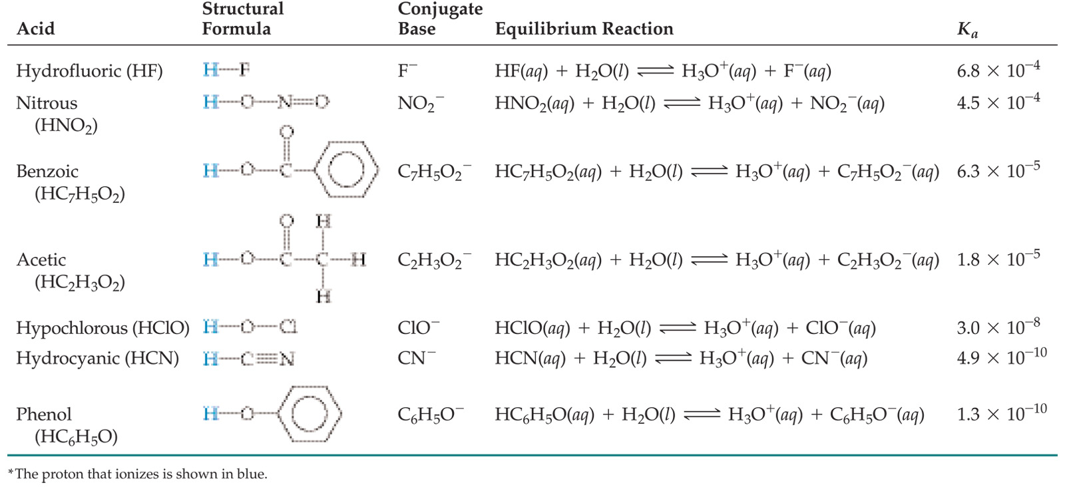
Weak acids and Weak bases
A weak acid:
The partial ionization of a weak acid in solution results in a mixture of ions and unionized acid in solution at equilibrium:
Examples:

Slide 42
Weak acids and Weak bases
A weak acid:
The partial ionization of a weak acid in solution results in a mixture of ions and unionized acid in solution at equilibrium:
Note:
The higher the value of K_{a}, the relatively stronger
the weak acid is, the lower the pH is

Slide 43
Weak acids and Weak bases
Example:
Which one of the following is the weakest acid?
A) Acetic acid (K_{a} = 1.8 × 10⁻⁵)
B) HNO₂ (K_{a} = 4.5 × 10⁻⁴)
C) HCN (K_{a} = 4.9 × 10⁻¹⁰)
D) HClO (K_{a} = 3.0 × 10⁻⁸)
E) HF (K_{a} = 6.8 × 10⁻⁴)
Solution Approach
Consider the value of K_{a}, where the lower the value of K_{a},
the weaker the acid is
HCN (K_{a} = 4.9 × 10⁻¹⁰) is the weakest, and HF (K_{a} = 6.8 × 10⁻⁴)
is, relatively, the strongest among the list

Slide 44
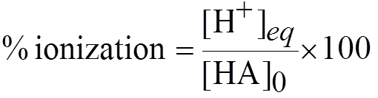
Weak acids and Weak bases
Calculations of pH of a weak acid
Weak acids partially ionize through an equilibrium.
Therefore, equilibrium calculations can be used to find [H⁺] at equilibrium, from which pH can be calculated
Percent ionization is another method to assess relative acid strength
Note: The higher the value of K_{a}, the higher the % ionization

Slide 45
Weak acids and Weak bases
Example:
In which of the following aqueous solutions does the weak
acid exhibit the highest percentage ionization?
A) 0.01 M HF (K_{a} = 6.8 × 10⁻⁴)
B) 0.01 M HNO₂ (K_{a} = 4.5 × 10⁻⁴)
C) 0.01 M HC₂H₃O₂ (K_{a} = 1.8 × 10⁻⁵)
D) 0.01 M HClO (K_{a} = 3.0 × 10⁻⁸)
E) These will all exhibit the same percentage ionization
Solution Approach
Consider the values of K_{a}, HF (K_{a} = 6.8 × 10⁻⁴) has the highest
K_{a} value, which indicates the highest percent ionization

Slide 46
Weak acids and Weak bases
Example:
The K_{a} for Niacin (vitamin B; C₅H₄N-COOH) is 1.6 x 10⁻⁵.
What is the pH of a 0.01 M solution of niacin?
Calculate the percentage of Niacin molecules ionized.
Solution Approach
This is a normal equilibrium problem, where both [HA]₀ and
K_{a} are given
Therefore and through equilibrium calculations, [H⁺]_{eq}
should be calculated, from which both pH and % ionization
can be calculated.

Slide 47
Weak acids and Weak bases
Example:
The K_{a} for Niacin (vitamin B; C₅H₄N-COOH) is 1.6 x 10⁻⁵.
What is the pH of a 0.01 M solution of niacin?
Calculate the percentage of Niacin molecules ionized.
Solution:
For simplicity, refer to Niacin as HA,
where K_{a} (1.6 x 10⁻⁵) is given as:
 | HA (aq) H⁺ (aq) + A⁻ (aq)
Initial (I) | 0.01 | 0 | 0
Change (Δ) | - x | + x | + x
Equi (Eq) | 0.01 – x | x | x

Slide 48
Weak acids and Weak bases
Example:
The K_{a} for Niacin (vitamin B; C₅H₄N-COOH) is 1.6 x 10⁻⁵.
What is the pH of a 0.01 M solution of niacin?
Calculate the percentage of Niacin molecules ionized.
Solution:
Solve it using the quadratic equation to find the value of x
Note that x = [H⁺]_{eq}, from which pH can be calculated
Us the following equation to calculate the % ionization

Slide 49
Weak acids and Weak bases
Example:
A 0.1 M solution of Lactic acid (C₂H₅O-COOH) has a pH
of 2.44. Calculate K_{a}
Solution Approach
This is also a normal equilibrium problem, where both [HA]₀
and pH are given
Note that the pH value represents the final [H⁺] at
equilibrium.
Therefore, [H⁺]_{eq} = 10^{-pH} → [H⁺] = 10^{-2.44} = 3.6 x 10⁻³
→ To solve it, equilibrium calculations are also needed

Slide 50
Weak acids and Weak bases
Example:
A 0.1 M solution of Lactic acid (C₂H₅O-COOH) has a pH
of 2.44. Calculate K_{a}
Solution:
For simplicity, refer to Lactic acid as HA,
Where its K_{a} is given as:
 | HA (aq) H⁺ (aq) + A⁻ (aq)
Initial (I) | 0.1 | 0 | 0
Change (Δ) | - x | + x | + x
Equi (Eq) | 0.1 – x | x | x
Where [H⁺]_{eq} = x = 3.6 x 10⁻³

Slide 51
Weak acids and Weak bases
Example:
A 0.1 M solution of Lactic acid (C₂H₅O-COOH) has a pH
of 2.44. Calculate K_{a}
Solution:
For simplicity, refer to Lactic acid as HA,
Where its K_{a} is given as:
 | HA (aq) H⁺ (aq) + A⁻ (aq)
Initial (I) | 0.1 | 0 | 0
Change (Δ) | - 3.6 x 10⁻³ | + 3.6 x 10⁻³ | + 3.6 x 10⁻³
Equi (Eq) | 0.1 – 3.6 x 10⁻³ | 3.6 x 10⁻³ | 3.6 x 10⁻³
→ Solve it for K_{a}

Slide 52
Weak acids and Weak bases
Example:
How many moles of HF (K_{a} = 6.8 x 10⁻⁴) must be present in
0.200 L to form a solution with a pH of 3.25?
Solution Approach
This is also a normal equilibrium problem, where both K_{a}
and pH are given → [HA]₀ is unknown, from which the
number of moles (n_{HA}) can be calculated
Note that the pH value represents the final [H⁺] at
equilibrium.
Therefore, [H⁺]_{eq} = 10^{-pH} → [H⁺] = 10^{-3.25} = 5.6 x 10⁻⁴
→ To solve it, equilibrium calculations are also needed

Slide 53
Weak acids and Weak bases
Example:
How many moles of HF (K_{a} = 6.8 x 10⁻⁴) must be present in
0.200 L to form a solution with a pH of 3.25?
Solution:
For simplicity, refer to HF as HA,
Where its K_{a} is given as:
 | HA (aq) H⁺ (aq) + A⁻ (aq)
Initial (I) | Y | 0 | 0
Change (Δ) | - x | + x | + x
Equi (Eq) | Y – x | x | x
Where [H⁺]_{eq} = x = 5.6 x 10⁻⁴

Slide 54
Weak acids and Weak bases
Example:
How many moles of HF (K_{a} = 6.8 x 10⁻⁴) must be present in
0.200 L to form a solution with a pH of 3.25?
Solution:
For simplicity, refer to Lactic acid as HA,
Where its K_{a} is given as:
 | HA (aq) H⁺ (aq) + A⁻ (aq)
Initial (I) | Y | 0 | 0
Change (Δ) | - 5.6 x 10⁻⁴ | + 5.6 x 10⁻⁴ | + 5.6 x 10⁻⁴
Equi (Eq) | Y – 5.6 x 10⁻⁴ | 5.6 x 10⁻⁴ | 5.6 x 10⁻⁴
→ Knowing the value of K_{a} , solve it for Y (= [HA]₀), then n_{HA}

Slide 55
Weak acids and Weak bases
Polyprotic weak acids:
Polyprotic acids have more than one ionizable proton. The protons are removed in steps not all at once.
If the difference between the K_{a} for the first dissociation and subsequent K_{a} values is 10³ or more, the pH generally depends only on the first dissociation
Example:

Slide 56
Weak acids and Weak bases
Polyprotic weak acids:
Example:
Note:
It is always easier to remove the first proton in a polyprotic acid than the second.
→ Therefore, K_{a1} > K_{a2} > K_{a3} etc.

Slide 57
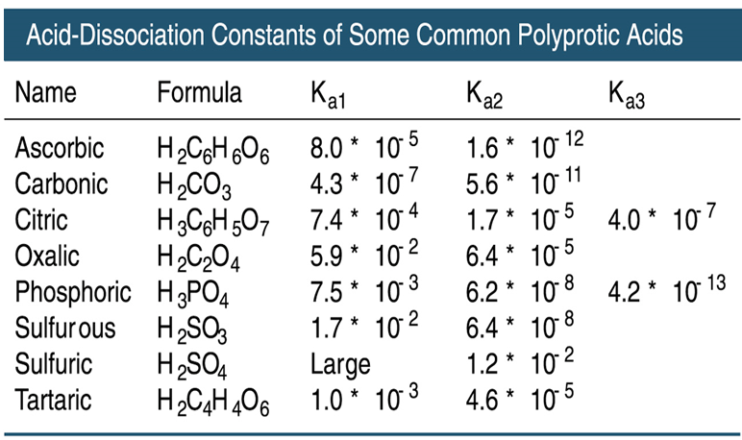
Weak acids and Weak bases
Polyprotic weak acids:
Examples:

Slide 58
Weak acids and Weak bases
Polyprotic weak acids:
Example:
Calculate the pH and concentration of oxalate ion, [C₂O₄²⁻] in a 0.02 M solution of oxalic acid (H₂C₂O₄).
(K_{a1} = 5.9 x 10⁻² & K_{a2} = 6.4 x 10⁻⁵)
Solution Approach
This is a diprotic acid, that ionizes over two steps, both at
equilibrium. The K_{a} values of both equilibrium reactions are
given as well as the [HA]₀
The pH of this solution is to be calculated from the final
overall [H⁺] after the first and second steps of ionization
are completed.

Slide 59
Weak acids and Weak bases
Polyprotic weak acids:
Example:
Calculate the pH and concentration of oxalate ion, [C₂O₄²⁻] in a 0.02 M solution of oxalic acid (H₂C₂O₄).
(K_{a1} = 5.9 x 10⁻² & K_{a2} = 6.4 x 10⁻⁵)
Solution Approach
Therefore, two (2) equilibrium calculations have to be made
To find the final overall [H⁺], hence the final pH value, and
the oxalate [C₂O₄²⁻] concentration

Slide 60
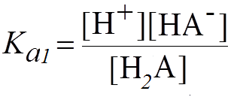

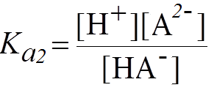

Weak acids and Weak bases
Polyprotic weak acids:
Example:
Calculate the pH and concentration of oxalate ion, [C₂O₄²⁻] in a 0.02 M solution of oxalic acid (H₂C₂O₄).
(K_{a1} = 5.9 x 10⁻² & K_{a2} = 6.4 x 10⁻⁵)
Solution:
For simplicity, refer to Oxalix acid as H₂A, where its
K_{a1} and K_{a2} expressions are given as:

Slide 61
Weak acids and Weak bases
Polyprotic weak acids:
Example:
Calculate the pH and concentration of oxalate ion, [C₂O₄²⁻] in a 0.02 M solution of oxalic acid (H₂C₂O₄).
(K_{a1} = 5.9 x 10⁻² & K_{a2} = 6.4 x 10⁻⁵)
Solution:
We start
with the
first
reaction:
Initial (I) | 0.02 | 0 | 0
Change (Δ) | - x | + x | + x
Equi (Eq) | 0.02 – x | x | x
Knowing the value of K_{a1} , solve it for x (= [HA⁻] and [H⁺])
Value of x at the end of 1st step are used as initial of step 2

Slide 62
Weak acids and Weak bases
Polyprotic weak acids:
Example:
Calculate the pH and concentration of oxalate ion, [C₂O₄²⁻] in a 0.02 M solution of oxalic acid (H₂C₂O₄).
(K_{a1} = 5.9 x 10⁻² & K_{a2} = 6.4 x 10⁻⁵)
Solution:
We start
with the
second
reaction:
Initial (I) | x | x | 0
Change (Δ) | y | + y | + y
Equi (Eq) | x – y | x + y | y
Knowing the value of K_{a2} and the value of x, solve for y
(then x+y = [H⁺]_{total}), while y = [A²⁻], which is [C₂O₄²⁻]_{eq}

Slide 63
Weak acids and Weak bases
Weak bases:
Bases react with water to produce hydroxide ion
Example:
Which is also an equilibrium, that has a K_{eq} known as K_{b}
(b stands for base), which is the base dissociation constant,
and has the following expression
In general, a weak base should react with H₂O to release
OH⁻ ions that will be used to calculate the pH of the medium

Slide 64

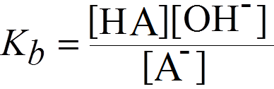
Weak acids and Weak bases
Weak bases:
Bases react with water to produce hydroxide ion
Therefore:
A general reaction of the weak base (A⁻) with water can be
shown as:
Which has the K_{b} expression:

Slide 65
Weak acids and Weak bases
Example:
A solution of NH₃ in water has a pH of 10.50. What is the
molarity of the solution? (K_{b} = 1.8 x 10⁻⁵)
Solution Approach
As a weak base, the best start point is to write a correct
Equilibrium equation by reacting the base (NH₃) with H₂O
With the K_{b} expression given as
where the final pH at equilibrium
Is given as 10.50 → pOH = 3.5
→ [OH-] = 10^{-3.5} = 3.2 x 10⁻⁴ M

Slide 66
Weak acids and Weak bases
Example:
A solution of NH₃ in water has a pH of 10.50. What is the
molarity of the solution? (K_{b} = 1.8 x 10⁻⁵)
Solution:
Knowing the K_{b} and [OH⁻]_{eq} should make it easy to
calculate the initial molarity of NH₃. To find it, equilibrium
Calculations have to be made, where [OH⁻]_{eq} = y in the table.
Initial (I) | x | 0 | 0
Change (Δ) | y | + y | + y
Equi (Eq) | x – y | x + y | y

Slide 67
Weak acids and Weak bases
Example:
A solution of NH₃ in water has a pH of 10.50. What is the
molarity of the solution? (K_{b} = 1.8 x 10⁻⁵)
Solution:
Knowing the K_{b} and [OH⁻]_{eq} should make it easy to
calculate the initial molarity of NH₃. To find it, equilibrium
Calculations have to be made, where [OH⁻]_{eq} = y in the table.
Initial (I) | x | 0 | 0
Change (Δ) | - 3.2 x 10⁻⁴ | 3.2 x 10⁻⁴ | 3.2 x 10⁻⁴
Equi (Eq) | x – 3.2 x 10⁻⁴ | 3.2 x 10⁻⁴ | 3.2 x 10⁻⁴
→ Apply the K_{b} expression to find the value of y (= [NH₃]₀)

Slide 68
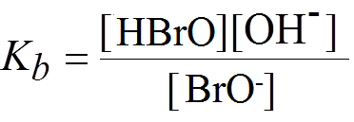
Weak acids and Weak bases
Example:
Calculate the molar concentration of OH⁻ ions in a 0.550 M solution of hypobromite ion (BrO⁻; K_{b} = 4.0 x 10⁻⁶). What is the pH of this solution?
Solution Approach
The hypobromite ion (BrO⁻) is a conjugate base of HBrO,
which is a weak acid. Therefore, we treat BrO⁻ as a weak base.
To start solving the problem, write the correct equilibrium
Reaction of BrO⁻ with H₂O, and its K_{b} expression:

Slide 69
Weak acids and Weak bases
Example:
Calculate the molar concentration of OH⁻ ions in a 0.550 M solution of hypobromite ion (BrO⁻; K_{b} = 4.0 x 10⁻⁶). What is the pH of this solution?
Solution:
Knowing the [BrO⁻]₀ and K_{b} will help getting [OH⁻]_{eq} through
normal equilibrium calculations
Initial (I) | 0.55 | 0 | 0
Change (Δ) | - x | + x | + x
Equi (Eq) | 0.55 - x | x | x
Use the quadratic equation to find the value of x, which is equal
to [OH⁻]_{eq}, from which pOH then pH can be also calculated

Slide 70
Acid-base Equilibrium
Relationship between K_{a} and K_{b}

Slide 71



Relationship between K_{a} and K_{b}
Consider the generic reactions of a weak acid and a weak base:
Adding the 2 reactions to each other:
→

Slide 72
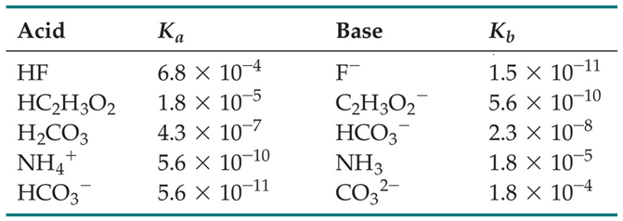
Relationship between K_{a} and K_{b}
Therefore, K_{a} and K_{b} are related to each other through a constant value (K_{w} = 1 x 10⁻¹⁴)
Examples:
→ Knowing one of them will let us calculate the other

Slide 73
Relationship between K_{a} and K_{b}
Example:
Which of the compounds below, a 0.1 M aqueous solution of it will have the highest pH?
NaOAc, K_{a} of HOAc = 1.8 × 10⁻⁵
NaClO, K_{a} of HClO = 3.2 × 10⁻⁸
C) NH₄NO₃, K_{b} of NH₃ = 1.8 × 10⁻⁵
D) KCN, K_{a} of HCN = 4.0 × 10⁻¹⁰
E) NaHS, K_{b} of HS⁻ = 1.8 × 10⁻⁷
Solution Approach
The given solutions are given K_{a} or K_{b} values. Since the
question is about highest pH, so it is recommended to make
them all in the form of K_{b}, so that the highest K_{b} will indicate
the highest [OH-]. Use K_{a}.K_{b} = K_{w} to convert K_{a} to K_{b}

Slide 74
Relationship between K_{a} and K_{b}
Example:
Which of the compounds below, a 0.1 M aqueous solution of it will have the highest pH?
NaOAc, K_{a} of HOAc = 1.8 × 10⁻⁵ → K_{b} = 5.6 x 10⁻¹⁰
NaClO, K_{a} of HClO = 3.2 × 10⁻⁸ → K_{b} = 3.1 x 10⁻⁷
C) NH₄NO₃, K_{b} of NH₃ = 1.8 × 10⁻⁵
D) KCN, K_{a} of HCN = 4.0 × 10⁻¹⁰ → K_{b} = 2.5 x 10⁻⁵
E) NaHS, K_{b} of HS⁻ = 1.8 × 10⁻⁷
Solution:
Comparing the K_{b} values, it shows that HCN has the highest
K_{b} value, hence the highest [OH⁻], and highest pH value

Slide 75
Relationship between K_{a} and K_{b}
Example:
Sorbic acid (C₅H₇COOH) is a weak monoprotic acid with
K_{a} = 1.7 x 10⁻⁵. what is the pH of a solution containing 11.25 g of sodium sorbate (C₅H₇COONa) in 1.75 L of solution? (Molecular weight of Sorbic acid is 112 g/mol)
Solution Approach
The actual question is about finding the pH value of a solution
Of the salt (sorbate), which is a conjugate (weak) base of the
Weak acid (Sorbic Acid). i.e., it is a weak base problem
The K_{a} value of Sorbic acid is therefore used to find the K_{b}
Value of its conjugate base (sorbate) using K_{a}.K_{b} = K_{w} to find it

Slide 76
Relationship between K_{a} and K_{b}
Example:
Sorbic acid (C₅H₇COOH) is a weak monoprotic acid with
K_{a} = 1.7 x 10⁻⁵. what is the pH of a solution containing 11.25 g of potassium sorbate (C₅H₇COONa) in 1.75 L of solution? (Molecular weight of Sorbic acid is 112 g/mol)
Solution Approach
The molecular weight of the salt (C₅H₇COONa; X⁻) is different
from that of the acid (C₅H₇COOH) by replacing H by Na
i.e. Molecular weight of the salt is 112 (-1)(+23) = 134
Therefore the starting molarity of the salt (weak base; X⁻)
is: (11.25/134) / 1.75 = 0.048 M
→ Now start the equilibrium calculations of the weak base X⁻

Slide 77
Relationship between K_{a} and K_{b}
Example:
Sorbic acid (C₅H₇COOH) is a weak monoprotic acid with
K_{a} = 1.7 x 10⁻⁵. what is the pH of a solution containing 11.25 g of potassium sorbate (C₅H₇COONa) in 1.75 L of solution? (Molecular weight of Sorbic acid is 112 g/mol)
Solution:
Initial (I) | 0.048 | 0 | 0
Change (Δ) | - x | + x | + x
Equi (Eq) | 0.048 - x | x | x
Where K_{b} = (1 x 10⁻¹⁴ / 1.7 x 10⁻⁵) = 5.9 x 10⁻¹⁰
Use this value in the K_{b} expression, and use the quadratic
Equation to find the value of x (= [OH⁻]_{eq}), then the pH

Slide 78
Acid-base Equilibrium
Acid-base properties of salt solutions

Slide 79
Acid-base properties of salt solutions
Example:
Salts are usually made by reacting an acid with a base
HX _{(aq)} + MOH _{(aq)} → MX _{(aq)} + H₂O _{(l)}
As shown,
the cation of the salt is originally from the base,
While the anion of the salt is originally from the acid
Therefore, if a salt is added to water, its effect on the pH
of the resultant solution depends on the acid and base
where the anion and cation of the salt coming from,
respectively.
→ These are based on the following rules

Slide 80
Acid-base properties of salt solutions
Example:
Considering the cation in a MX salt:
If the cation is coming from a strong base (LiOH, NaOH,
KOH, RbOH, Ca(OH)₂, Sr(OH)₂, or Ba(OH)₂), then it is
called a spectator (watching) ion that will not affect the
pH of the solution → neutral (N)
If the cation is coming from a weak base (such as NH₃,
transition metal hydroxides, or organic bases), then being
a cation will force it to react with OH⁻ of H₂O, leaving
behind more H⁺ in solution → acidic (A)

Slide 81
Acid-base properties of salt solutions
Example:
Considering the anion in a MX salt:
If the anion is coming from a strong acid (HCl, HBr, HI,
HNO₃, H₂SO₄, HClO₃, HClO₄), then it is called a spectator
(watching) ion that will not affect the pH of the solution
→ neutral (N)
If the anion is coming from a weak acid (such as HF, or
organic acid), then being an anion will force it to react
with H⁺ of H₂O, leaving behind more OH⁻ in solution
→ basic (A)

Slide 82
Acid-base properties of salt solutions
Example:
Considering the cation and anion in a MX salt:
If the cation and the anion are coming from strong acid,
and strong base, respectively, then neither of them will
affect the pH of the solution (both are spectator ions)
→ neutral (N)
If the cation and the anion are coming from weak acid,
and weak base, respectively, then the cation will make
the solution acidic, while the anion will make the solution
basic. This does not mean an overall neutral pH solution,
because this will depend on the K_{a} and K_{b} of the weak
acid and weak base, where the anion and the cation are
coming from → The final pH depends on K_{a} and K_{b} values

Slide 83
Acid-base properties of salt solutions
Example:
In each of the following, indicate which salt will form the
more acidic (or less basic) 0.01 M solution:
a) NaNO₃, Fe(NO₃)₃
b) CH₃NH₃Cl, BaCl₂
d) NH₄NO₂, NH₄NO₃
Solution Approach
Each of the given salts should be analyzed in terms of the
effects of their cations and anions on the pH of the resultant
0.01 M Solution.

Slide 84
Acid-base properties of salt solutions
Example:
In each of the following, indicate which salt will form the
more acidic (or less basic) 0.01 M solution:
a) NaNO₃, Fe(NO₃)₃
b) CH₃NH₃Cl, BaCl₂
c) NH₄NO₂, NH₄NO₃
Note these abbreviations:
S: strong W: weak
A: acidic B: Basic N: Neutral
Solution:
a)
NaNO₃ |  | Fe(NO₃)₃
Na⁺ | NO₃⁻ | Fe³⁺ | NO₃⁻
NaOH / S | HNO₃ / S | Fe(OH)₃ / W | HNO₃ / S
N | N | A | N
Neutral |  | Acidic

Slide 85
Acid-base properties of salt solutions
Example:
In each of the following, indicate which salt will form the
more acidic (or less basic) 0.01 M solution:
a) NaNO₃, Fe(NO₃)₃
b) CH₃NH₃Cl, BaCl₂
c) NH₄NO₂, NH₄NO₃
Note these abbreviations:
S: strong W: weak
A: acidic B: Basic N: Neutral
Solution:
b)
CH₃NH₃Cl |  | BaCl₂
CH₃NH₃⁺ | Cl⁻ | Ba²⁺ | Cl⁻
CH₃NH₃OH/W | HCl / S | Ba(OH)₂ /S | HCl / S
A | N | N | N
Acidic |  | Neutral

Slide 86
Acid-base properties of salt solutions
Example:
In each of the following, indicate which salt will form the
more acidic (or less basic) 0.01 M solution:
a) NaNO₃, Fe(NO₃)₃
b) CH₃NH₃Cl, BaCl₂
c) NH₄NO₂, NH₄NO₃
Note these abbreviations:
S: strong W: weak
A: acidic B: Basic N: Neutral
Solution:
c)
NH₄NO₂ |  | NH₄NO₃
NH₄⁺ | NO₂⁻ | NH₄⁺ | NO₃⁻
NH₄OH / W | HNO₂/W | NH₄OH / W | HNO₃ / S
A | B | A | N
Depends on K_{a} & K_{b} |  | Acidic

Slide 87
Acid-base Equilibrium
End of Chapter 16

